Slide 1
Bottled Air Lakeland
By Edan Phillip and Richard Raybon

Slide 2

Objectives
Overall Goal
Bring website to front page
Sub-goals
Create functional website
Design website to look aesthetically pleasing
Optimize SEO

Slide 3

Approach
Simple design
Easy to navigate
Almost every page is accessible from every other page
Use SEO techniques
Proper page titles
Add schema to each page
Update sitemap and robots.txt

Slide 4
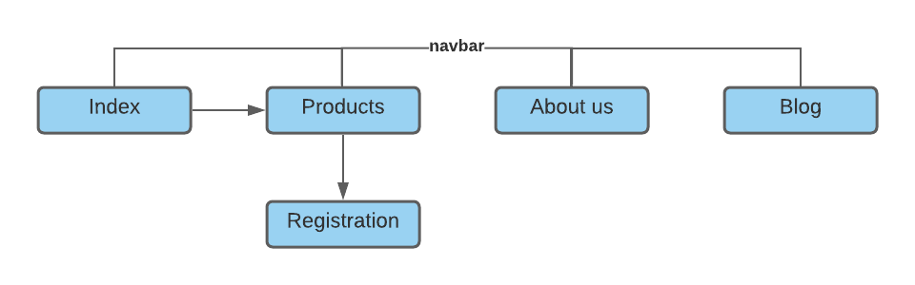
Outline of the site

Slide 5
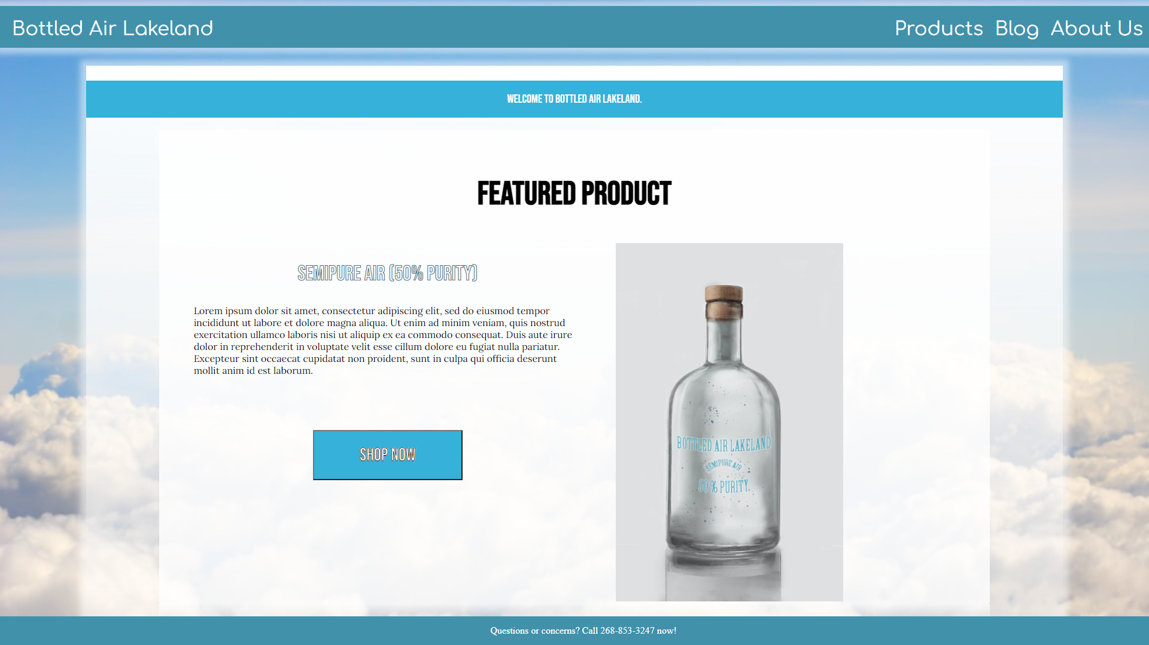
Website

Slide 6
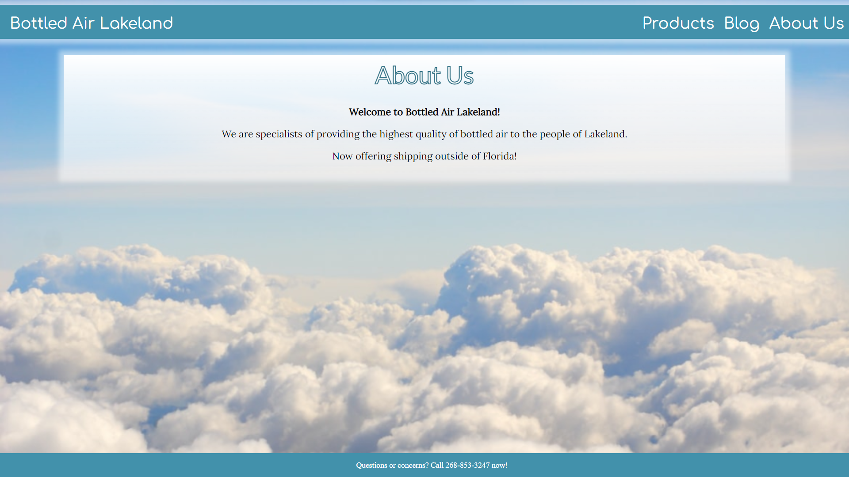

Slide 7
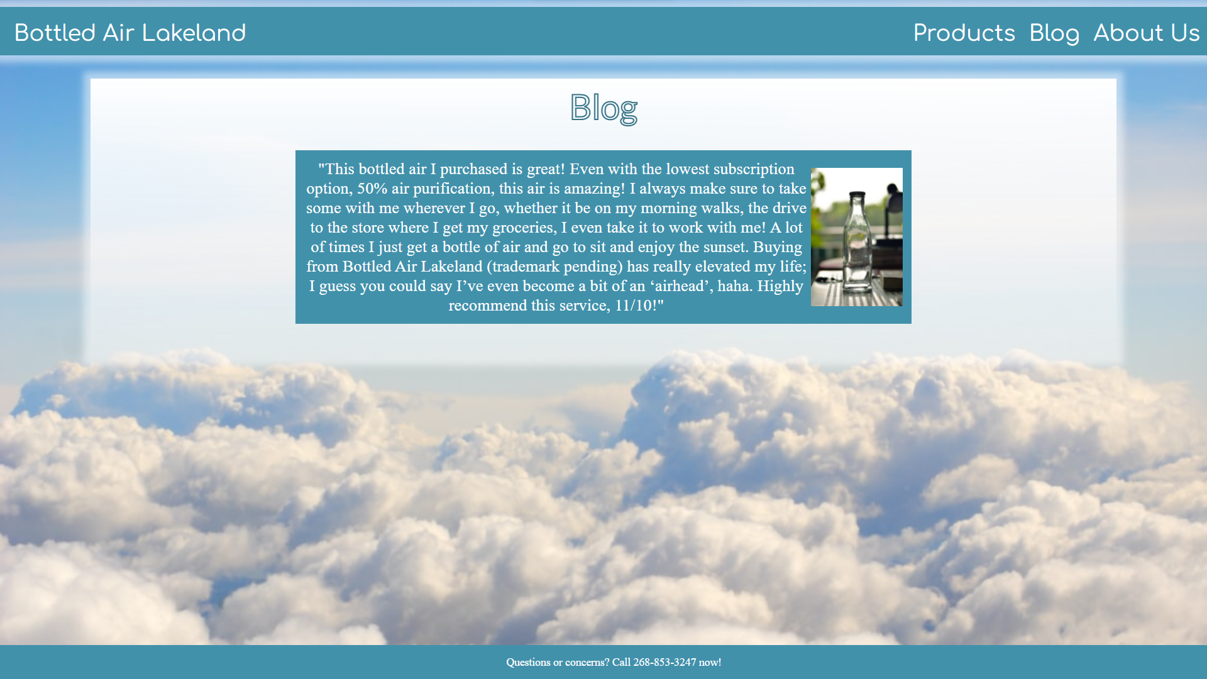

Slide 8
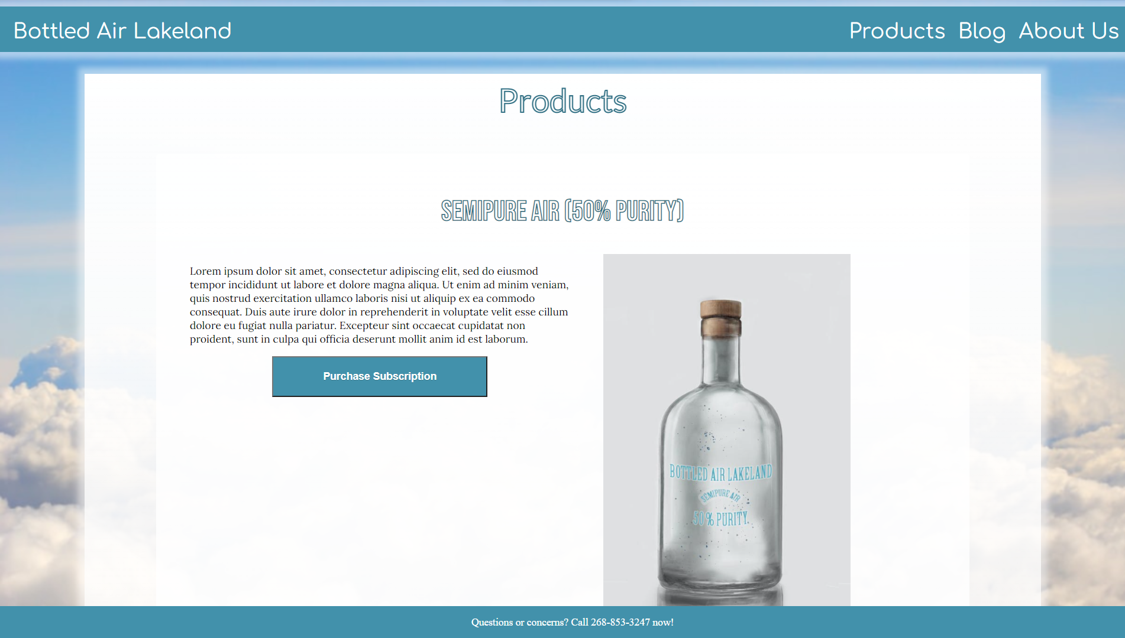
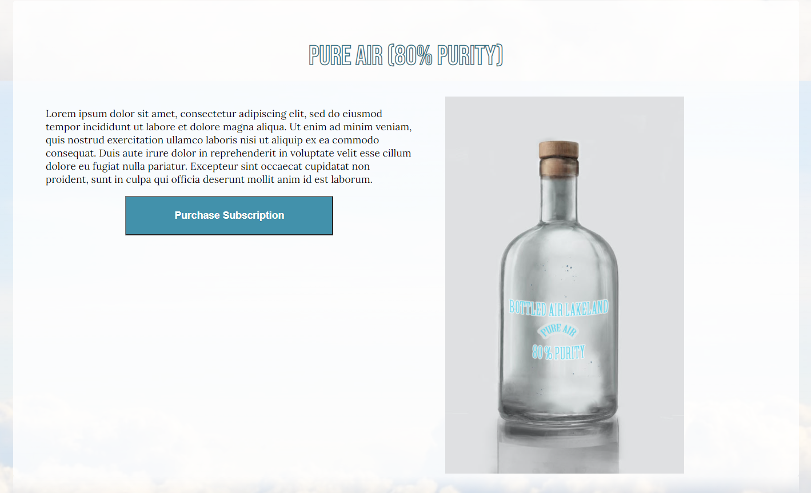
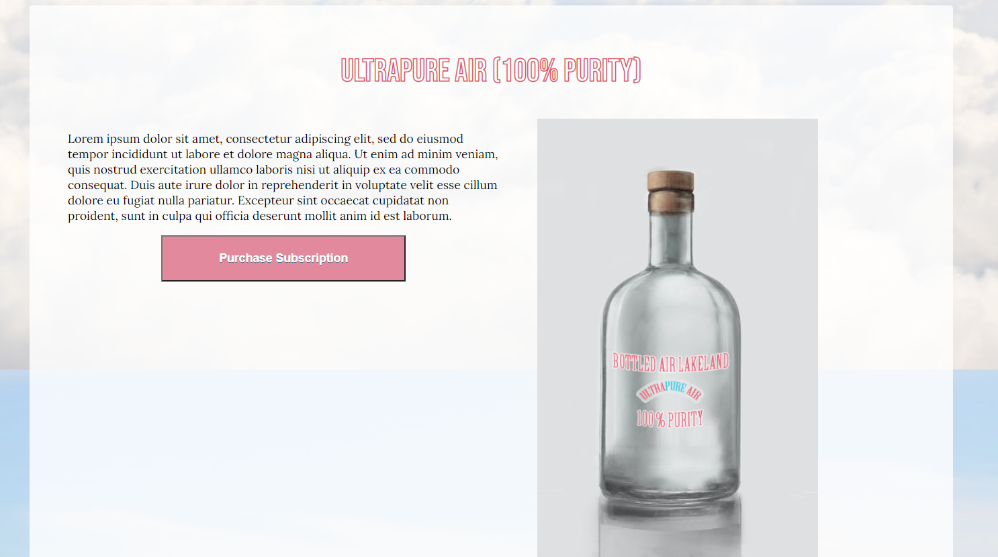

Slide 9
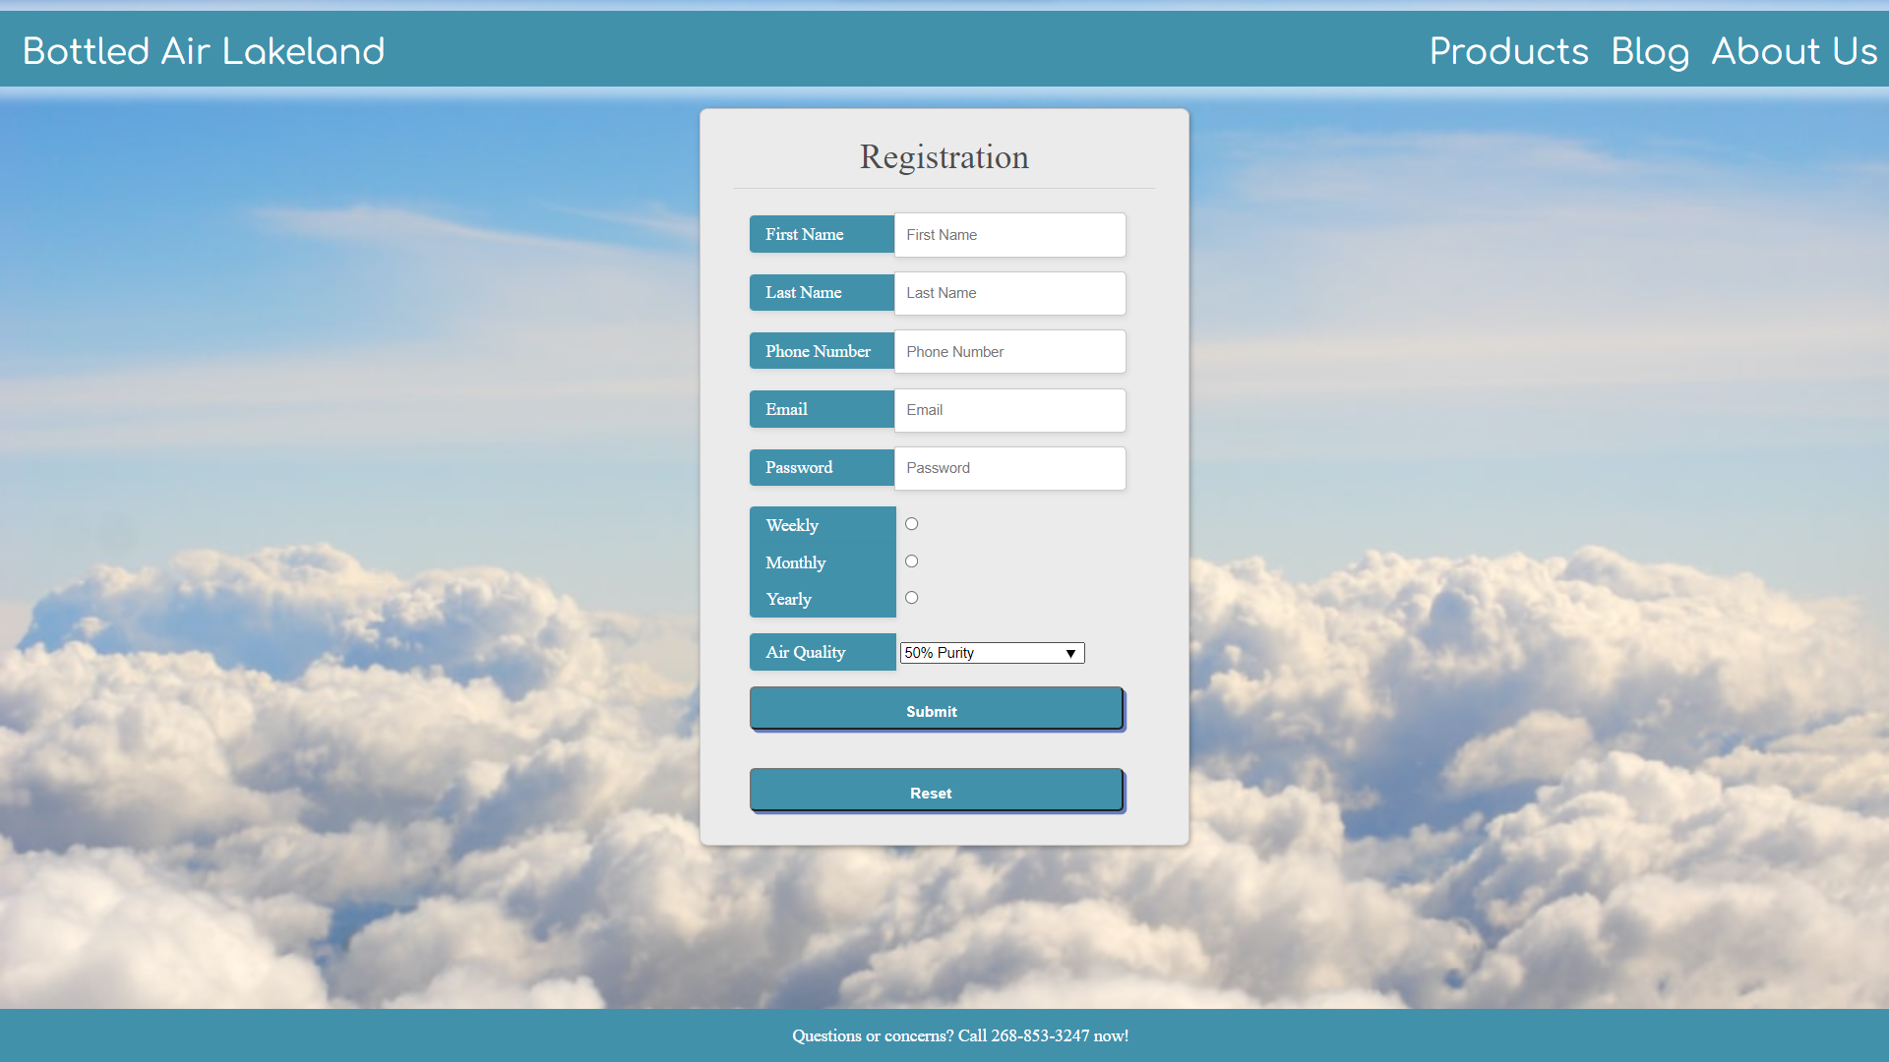

Slide 10
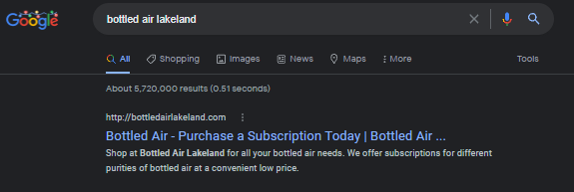
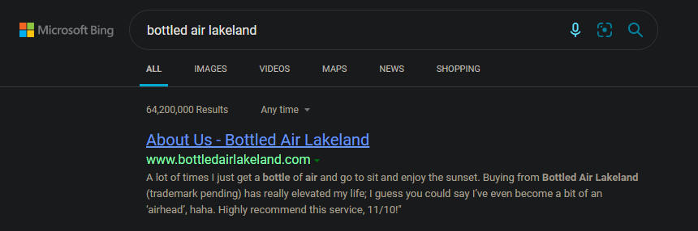
SEO Success

Slide 11
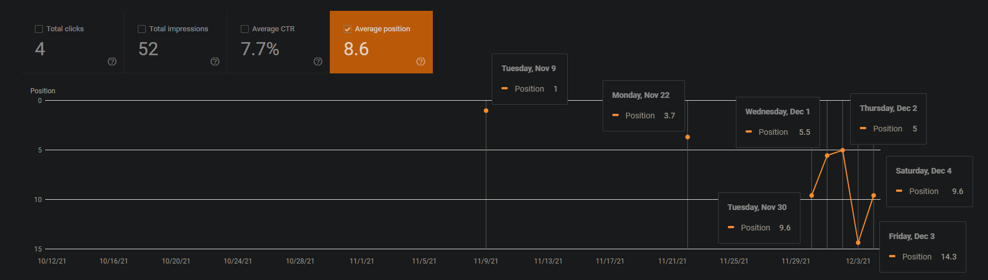
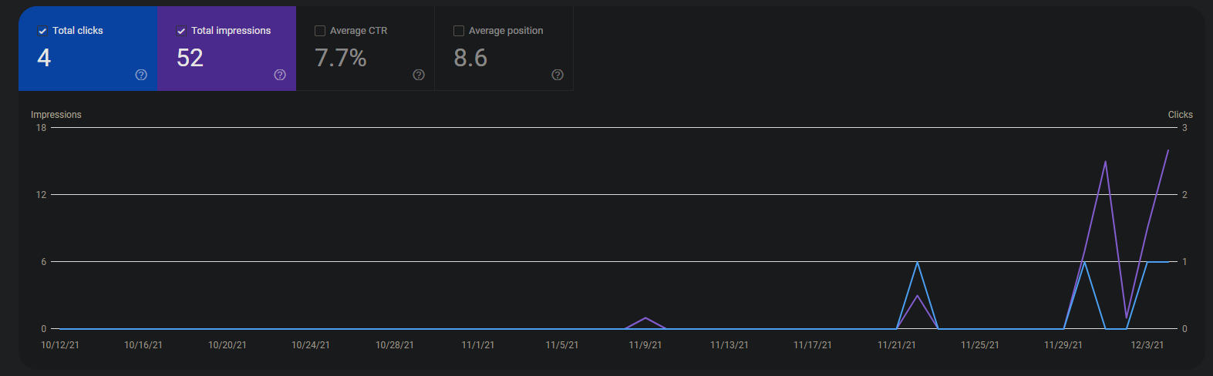
Analytics/Results
Little activity for the first 7 weeks.
Average position of 8.6

Slide 12
Lessons Learned
Request to index the sites early
It is better to update websites consistently
Neither of us like CSS
Web design is time consuming

